Slide 1

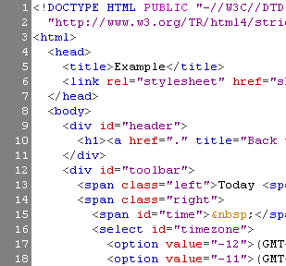


HTML Basics
HTML, Text, Images, Tables

Slide 2
Table of Contents
Introduction to HTML
How the Web Works?
What is a Web Page?
My First HTML Page
Basic Tags: Hyperlinks, Images, Formatting
Headings and Paragraphs
HTML in Details
The <!DOCTYPE> Declaration
The <head> Section: Title, Meta, Script, Style

Slide 3
Table of Contents
HTML in Details
The <body> Section
Text Styling and Formatting Tags
Hyperlinks: <a>, Hyperlinks and Sections
Images: <img>
Lists: <ol>, <ul> and <dl>
The <div> and <span> elements
HTML Tables
HTML Forms
3

Slide 4



How the Web Works?
WWW use classical client / server architecture
HTTP is text-based request-response protocol
HTTP
Page request
HTTP
Server response
Server running Web Server Software (e.g Apache)
Client running a Web Browser

Slide 5
What is a Web Page?
Web pages are text files containing HTML
HTML – Hyper Text Markup Language
The markup tags provide information about the page content structure

Slide 6
Creating HTML Pages
An HTML file must have.html file extension
HTML files can be created with text editors:
NotePad
Sublime
Or HTML editors (WYSIWYG Editors):
Microsoft FrontPage
Macromedia Dreamweaver
Visual Studio

Slide 7



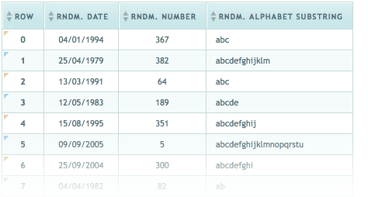
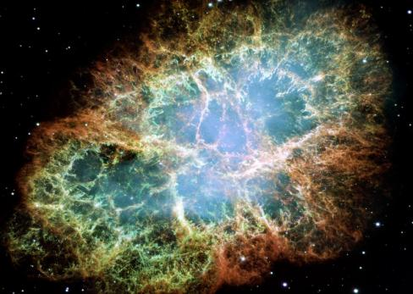
HTML Basics
Text, Images, Tables, Forms

Slide 8
HTML Structure
HTML is comprised of “tags”
Begins with <html> and ends with </html>
Elements (tags) are nested one inside another:
Tags have attributes:
HTML describes structure using two main sections: <head> and <body>
<html> <head></head> <body></body> </html>
<img src="logo.jpg" alt="logo" />

Slide 9
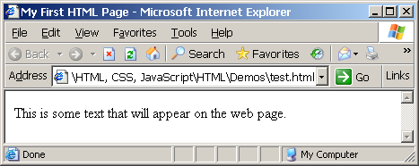
First HTML Page
test.html
<!DOCTYPE HTML>
<html>
<head>
<title>My First HTML Page</title>
</head>
<body>
<p>This is some text...</p>
</body>
</html>

Slide 10
First HTML Page: Tags
<!DOCTYPE HTML>
<html>
<head>
<title>My First HTML Page</title>
</head>
<body>
<p>This is some text...</p>
</body>
</html>
Opening tag
Closing tag
An HTML element consists of an opening tag, a closing tag and the content inside.

Slide 11
First HTML Page: Header
HTML header
<!DOCTYPE HTML>
<html>
<head>
<title>My First HTML Page</title>
</head>
<body>
<p>This is some text...</p>
</body>
</html>

Slide 12
First HTML Page: Body
<!DOCTYPE HTML>
<html>
<head>
<title>My First HTML Page</title>
</head>
<body>
<p>This is some text...</p>
</body>
</html>
HTML body

Slide 13
Some Simple Tags
Hyperlink Tags
Image Tags
Text formatting tags
<a href="https://www.google.com"
title="Telerik">Link to Telerik Web site</a>
<img src="logo.gif" alt="logo" />
This text is <em>emphasized.</em>
<br />new line<br />
This one is <strong>more emphasized.</strong>

Slide 14
Some Simple Tags – Example
some-tags.html
<!DOCTYPE HTML>
<html>
<head>
<title>Simple Tags Demo</title>
</head>
<body>
<a href="http://www.google.com/" title=
"Telerik site">This is a link.</a>
<br />
<img src="logo.gif" alt="logo" />
<br />
<strong>Bold</strong> and <em>italic</em> text.
</body>
</html>

Slide 15
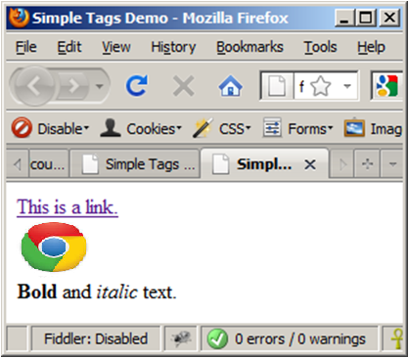
Some Simple Tags – Example (2)
some-tags.html
<!DOCTYPE HTML>
<html>
<head>
<title>Simple Tags Demo</title>
</head>
<body>
<a href="http://www.telerik.com/" title=
"Telerik site">This is a link.</a>
<br />
<img src="logo.gif" alt="logo" />
<br />
<strong>Bold</strong> and <em>italic</em> text.
</body>
</html>
Notes:
specifies an alternate text for an area, if the image cannot be displayed

Slide 16
Tags Attributes
Tags can have attributes
Attributes specify properties and behavior
Attributes provide additional information about an element
Attributes are always specified in the start tag
Attributes come in name/value pairs like: name="value"
Example:
Attribute alt with value "logo"
<img src="logo.gif" alt="logo" />
Notes:
Alt specifies an alternate text for an area, if the image cannot be displayed

Slide 17
Headings and Paragraphs
Heading Tags (h1 – h6)
Paragraph Tags
Sections: div and span
<h1>Heading 1</h1>
<h2>Sub heading 2</h2>
<h3>Sub heading 3</h3>
<p>This is my first paragraph</p>
<p>This is my second paragraph</p>
<div style="background: skyblue;">
This is a div</div>

Slide 18
Headings and Paragraphs – Example
headings.html
<!DOCTYPE HTML>
<html>
<head><title>Headings and paragraphs</title></head>
<body>
<h1>Heading 1</h1>
<h2>Sub heading 2</h2>
<h3>Sub heading 3</h3>
<p>This is my first paragraph</p>
<p>This is my second paragraph</p>
<div style="background:skyblue">
This is a div</div>
</body>
</html>

Slide 19
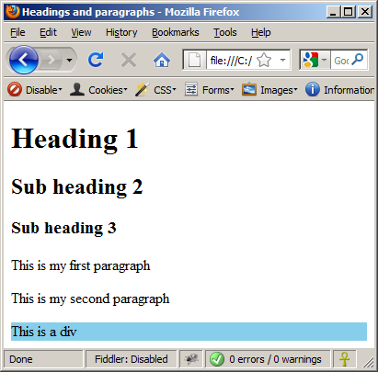
Headings and Paragraphs – Example (2)
headings.html
<!DOCTYPE HTML>
<html>
<head><title>Headings and paragraphs</title></head>
<body>
<h1>Heading 1</h1>
<h2>Sub heading 2</h2>
<h3>Sub heading 3</h3>
<p>This is my first paragraph</p>
<p>This is my second paragraph</p>
<div style="background:skyblue">
This is a div</div>
</body>
</html>

Slide 20
Text Formatting
Text formatting tags modify the text between the opening tag and the closing tag
Ex. <b>Hello</b> makes “Hello” bold
<b></b> | bold
<i></i> | italicized
<u></u> | underlined
<sup></sup> | Sample^{superscript}
<sub></sub> | Sample_{subscript}
<strong></strong> | strong
<pre></pre> | Preformatted text
<del></del> | Deleted text – strike through

Slide 21
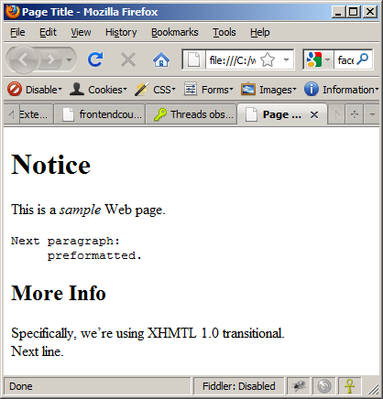
Text Formatting – Example
text-formatting.html
<html>
<head>
<title>Page Title</title>
</head>
<body>
<h1>Notice</h1>
<p>This is a <em>sample</em> Web page.</p>
<p><pre>Next paragraph:
preformatted.</pre></p>
<h2>More Info</h2>
<p>Specifically, we’re using XHMTL 1.0 transitional.<br />
Next line.</p>
</body>
</html>

Slide 22
Hyperlinks: <a> Tag
Link to a document called form.html on the same server in the same directory:
Link to a document called cat.html on the same server in the subdirectory stuff:
<a href="form.html">Fill Our Form</a>
<a href="stuff/cat.html">Catalog</a>

Slide 23
Images: <img> tag
Inserting an image with <img> tag:
Image attributes:
Example:
<img src="/img/basd-logo.png">
src | Location of image file (relative or absolute)
alt | Substitute text for display (e.g. in text mode)
height | Number of pixels of the height
width | Number of pixels of the width
border | Size of border, 0 for no border
<img src="./php.png" alt="PHP Logo" />

Slide 24
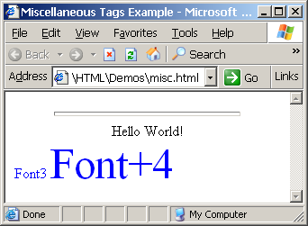
Miscellaneous Tags – Example
misc.html
<html>
<head>
<title>Miscellaneous Tags Example</title>
</head>
<body>
<hr size="5" width="70%" />
<center>Hello World!</center>
<font size="3" color="blue">Font3</font>
<font size="+4" color="blue">Font+4</font>
</body>
</html>

Slide 25
Ordered Lists: <ol> Tag
Create an Ordered List using <ol></ol>:
Attribute values for type are 1, A, a, I, or i
<ol type="1">
<li>Apple</li>
<li>Orange</li>
<li>Grapefruit</li>
</ol>
Apple
Orange
Grapefruit
Apple
Orange
Grapefruit
Apple
Orange
Grapefruit
Apple
Orange
Grapefruit
Apple
Orange
Grapefruit

Slide 26
Unordered Lists: <ul> Tag
Create an Unordered List using <ul></ul>:
Attribute values for type are:
disc, circle or square
<ul type="disk">
<li>Apple</li>
<li>Orange</li>
<li>Grapefruit</li>
</ul>
Apple
Orange
Pear
Apple
Orange
Pear
Apple
Orange
Pear

Slide 27
Definition lists: <dl> tag
Create definition lists using <dl>
Pairs of text and associated definition; text is in <dt> tag, definition in <dd> tag
Renders without bullets
Definition is indented
<dl>
<dt>HTML</dt>
<dd>A markup language …</dd>
<dt>CSS</dt>
<dd>Language used to …</dd>
</dl>

Slide 28
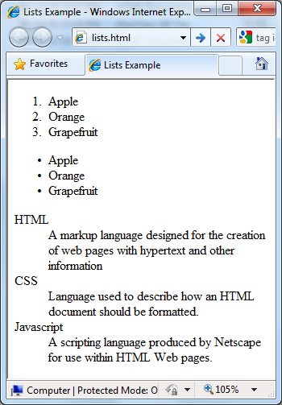
Lists – Example
lists.html
<ol type="1">
<li>Apple</li>
<li>Orange</li>
<li>Grapefruit</li>
</ol>
<ul type="disc">
<li>Apple</li>
<li>Orange</li>
<li>Grapefruit</li>
</ul>
<dl>
<dt>HTML</dt>
<dd>A markup lang…</dd>
</dl>

Slide 29
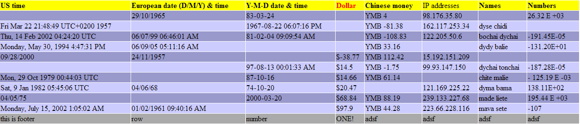
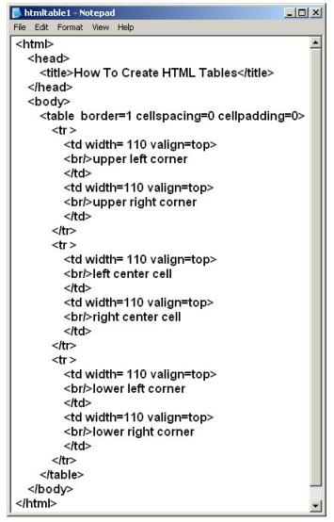
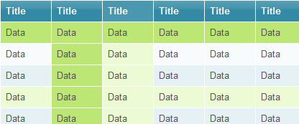
HTML Tables

Slide 30
HTML Tables
Tables represent tabular data
A table consists of one or several rows
Each row has one or more columns
Tables comprised of several core tags: <table></table>: begin / end the table <tr></tr>: create a table row <td></td>: create tabular data (cell)

Slide 31
HTML Tables (2)
Start and end of a table
Start and end of a row
Start and end of a cell in a row
<table> ... </table>
<tr> ... </tr>
<td> ... </td>

Slide 32
Simple HTML Tables – Example
<table cellspacing="0" cellpadding="5">
<tr>
<td><img src="ppt.gif"></td>
<td><a href="lecture1.ppt">Lecture 1</a></td>
</tr>
<tr>
<td><img src="ppt.gif"></td>
<td><a href="lecture2.ppt">Lecture 2</a></td>
</tr>
<tr>
<td><img src="zip.gif"></td>
<td><a href="lecture2-demos.zip">
Lecture 2 - Demos</a></td>
</tr>
</table>

Slide 33
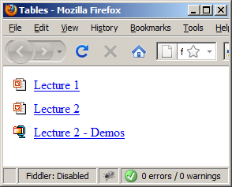
Simple HTML Tables – Example (2)
<table cellspacing="0" cellpadding="5">
<tr>
<td><img src="ppt.gif"></td>
<td><a href="lecture1.ppt">Lecture 1</a></td>
</tr>
<tr>
<td><img src="ppt.gif"></td>
<td><a href="lecture2.ppt">Lecture 2</a></td>
</tr>
<tr>
<td><img src="zip.gif"></td>
<td><a href="lecture2-demos.zip">
Lecture 2 - Demos</a></td>
</tr>
</table>

Slide 34
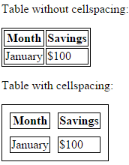
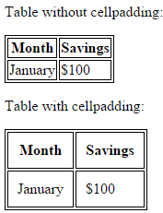
Cell Spacing and Padding
Tables have two important attributes:
cellspacing
Defines the empty space between cells
cellpadding
Defines the empty space around the cell content
cell
cell
cell
cell
cell
cell
cell
cell

Slide 35
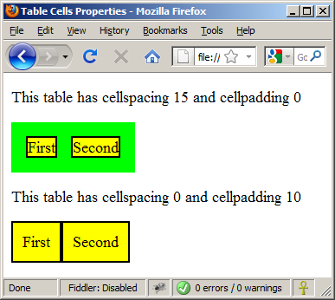
Cell Spacing and Padding – Example
table-cells.html
<html>
<head><title>Table Cells</title></head>
<body>
<table cellspacing="15" cellpadding="0">
<tr><td>First</td>
<td>Second</td></tr>
</table>
<br/>
<table cellspacing="0" cellpadding="10">
<tr><td>First</td><td>Second</td></tr>
</table>
</body>
</html>

Slide 36
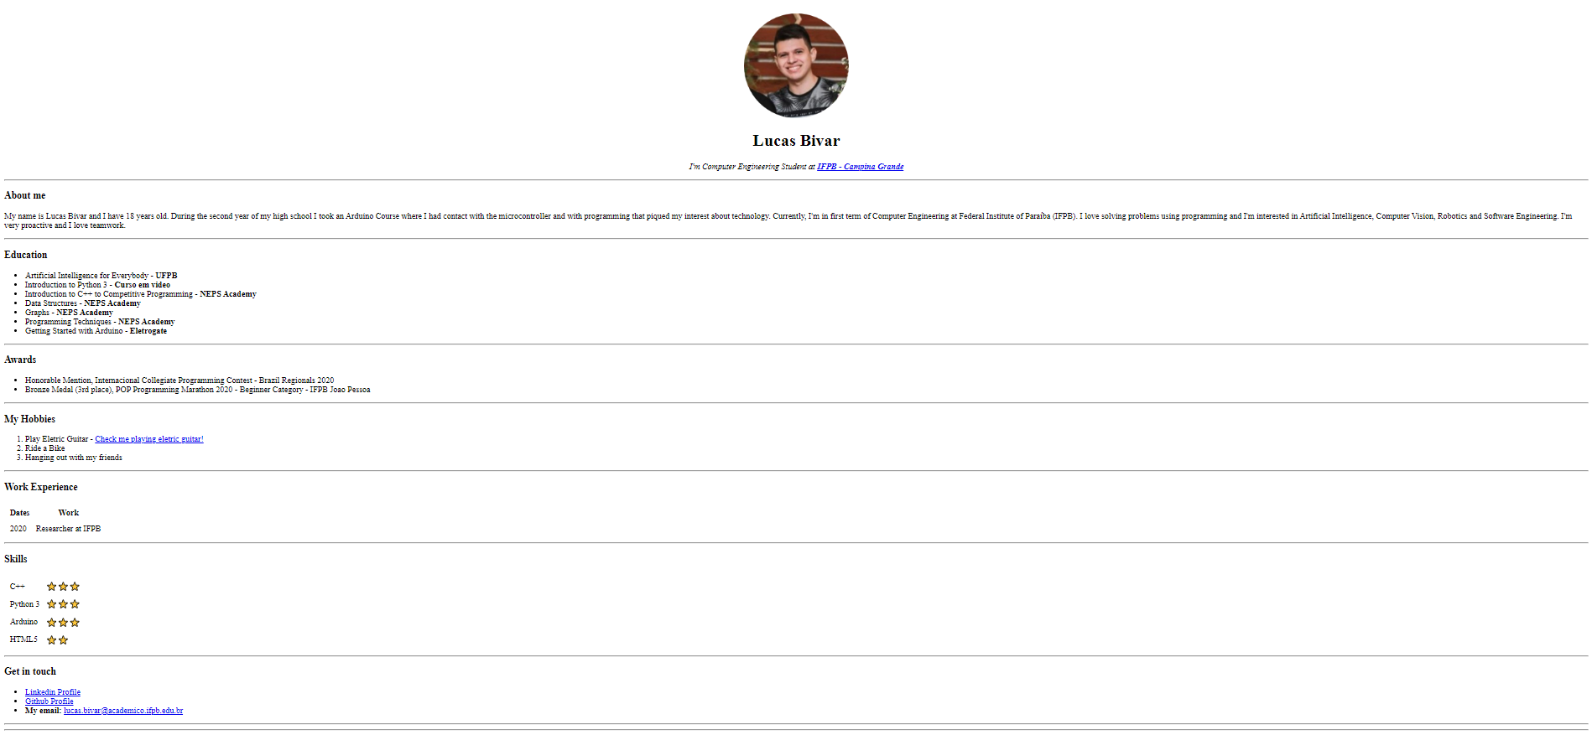
HTML Task

Slide 37
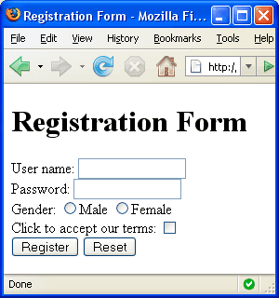


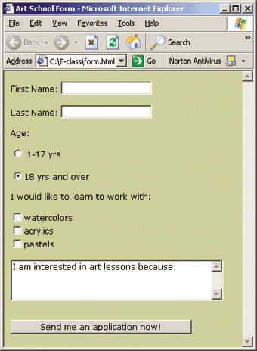
HTML Forms
Entering User Data from a Web Page

Slide 38
HTML Forms
Forms are the primary method for gathering data from site visitors
Create a form block with
Example:
The “method" attribute tells how the form data should be sent – via GET or POST request
<form></form>
<form name="myForm" method="post" action="path/to/some-script.php">
...
</form>
The "action" attribute tells where the form data should be sent

Slide 39
Form Fields
Single-line text input fields:
Multi-line textarea fields:
Hidden fields contain data not shown to the user:
<input type="text" name="FirstName" value="This is a text field" />
<textarea name="Comments">This is a multi-line text field</textarea>
<input type="hidden" name="Account" value="This is a hidden text field" />

Slide 40
Fieldsets
Fieldsets are used to enclose a group of related form fields:
The <legend> is the fieldset's title.
<form method="post" action="form.php">
<fieldset>
<legend>Client Details</legend>
<input type="text" id="Name" />
<input type="text" id="Phone" />
</fieldset>
<fieldset>
<legend>Order Details</legend>
<input type="text" id="Quantity" />
<textarea cols="40" rows="10" id="Remarks"></textarea>
</fieldset>
</form>

Slide 41
Form Input Controls
Checkboxes:
Radio buttons:
Radio buttons can be grouped, allowing only one to be selected from a group:
<input type="checkbox" name="fruit" value="apple" />
<input type="radio" name="title" value="Mr." />
<input type="radio" name="city" value="Lom" />
<input type="radio" name="city" value="Ruse" />

Slide 42
Other Form Controls
Dropdown menus:
Submit button:
<select name="gender">
<option value="Value 1"
selected="selected">Male</option>
<option value="Value 2">Female</option>
<option value="Value 3">Other</option>
</select>
<input type="submit" name="submitBtn" value="Apply Now" />

Slide 43
Other Form Controls (2)
Reset button – brings the form to its initial state
Image button – acts like submit but image is displayed and click coordinates are sent
<input type="reset" name="resetBtn" value="Reset the form" />
<input type="image" src="submit.gif" name="submitBtn" alt="Submit" />

Slide 44
Other Form Controls (3)
Password input – a text field which masks the entered text with * signs
Multiple select field – displays the list of items in multiple lines, instead of one
<input type="password" name="pass" />
<select name="products" multiple="multiple">
<option value="Value 1"
selected="selected">keyboard</option>
<option value="Value 2">mouse</option>
<option value="Value 3">speakers</option>
</select>

Slide 45
Other Form Controls (4)
File input – a field used for uploading files
When used, it requires the form element to have a specific attribute:
<input type="file" name="photo" />
<form enctype="multipart/form-data">
...
<input type="file" name="photo" />
...
</form>

Slide 46
Labels
Form labels are used to associate an explanatory text to a form field.
<label for="fn">First Name</label>

Slide 47
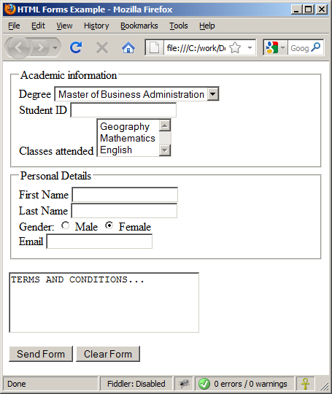
LAB TASK : HTML Form
LAB Task - Design following HTML Form

